Slide 1

Smart Resume Analyzer & Simple Job Recommender
Team Titans:
Diego Espinosa Carreno
Jose Enrique Fernandez Contreras
Valerie Samantha Solis
Lucy Tran

Slide 2
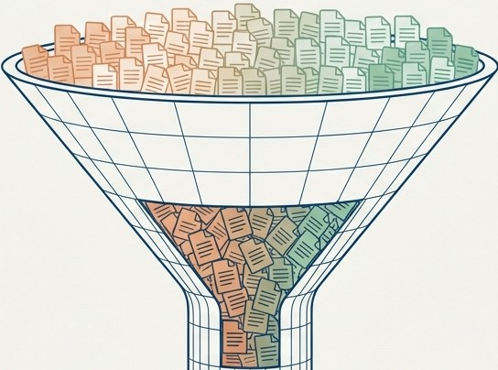




The Modern Recruitment Bottleneck
Overwhelming Volume
Manual screening struggles to keep up with thousands of resumes submitted weekly.
Inconsistent & Slow
The manual process is prone to human error, inconsistency, and significant delays.
�
Implicit Bias
Unconscious biases can lead to overlooking qualified candidates from diverse backgrounds.
The Cost of Missed Opportunities
High-quality candidates are frequently lost in the noise, a major loss for both the company and the applicant.
-
Isl\ NotebookLM

Slide 3





Our Objective: An Intelligent, Automated Screening System
. ⁻-
Extract Intelligence
Automatically parse and extract structured data (skills, experience) from unstructured resumes.
Ensure Precision Matching
Accurately match candidate profiles against specific job descriptions using a nuanced scoring model.
Discover Hidden Opportunities
Generate intelligent job recommendations for candidates based on their complete profile.
Guarantee Security &Speed
Build a self-contained system that runs locally for real-time processing without cloud dependencies.

Slide 4
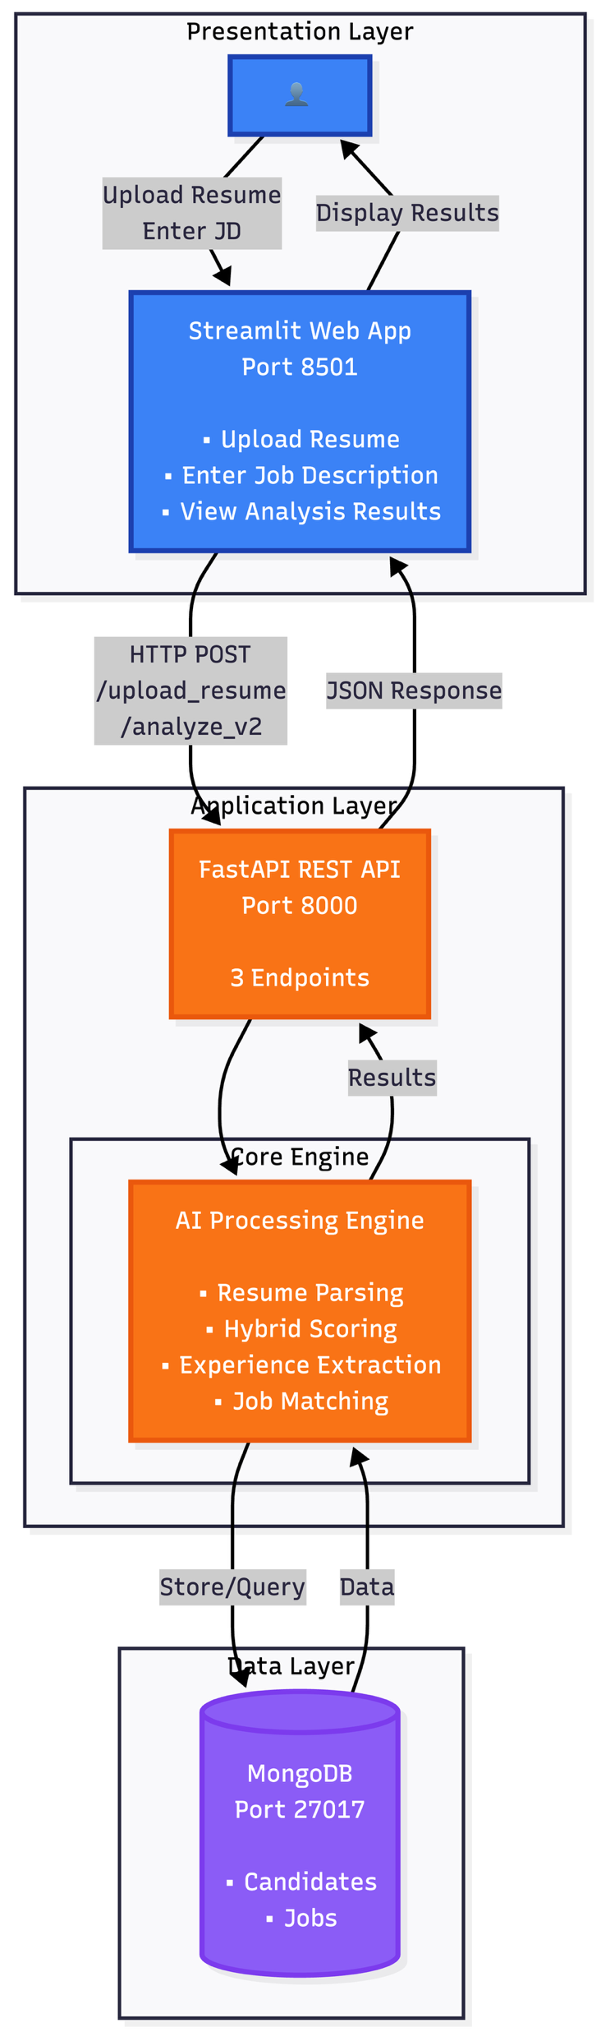
The System Architecture
Frontend (Tier 1): Streamlit (Python) for an interactive, local-first UI.
Backend (Tier 2): FastAPI handles parsing, NLP logic, and scoring endpoints.
Database (Tier 3): MongoDB stores candidate profiles and job descriptions.
Core Engine: Utilizes scikit-learn for TF-IDF and specialized libraries for BM25.

Slide 5
Data Flow

Slide 6
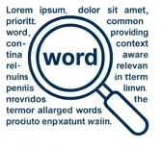

The Three Pillars of Our Scoring Algorithm
BM25 {45% Weight)
TF-IDF {30% Weight)
Jaccard {25% Weight)
✓--
✓□-₋- ₋
□--
□--
□--
Advanced Keyword Matching
Prioritizes rare, important terms over common words, providing context-aware relevance. It's like a smart search engine that knows "5 years of Python" is more significant than "worked with."
Context & Theme Similarity
Measures the thematic overlap between the resume and the job description. It asks, "Are these two documents talking about the same concepts?"
Hard Skill Verification
A direct, binary check of required skills. It calculates the simple ratio of matched skills to total required skills (e.g., Python, SQL, Docker found = 3/10 required).
Best For: Understanding the overall domain fit and preventing keyword stuffing.
Best For: Confirming baseline technical qualifications.
Best For: Identifying role-defining keywords and specific requirements.

Slide 7


Calibrating the Score: From Raw Data to Actionable Insight
Score Refinements
Match Level Thresholds
Experience Bonus
We reward verified experience to prioritize seasoned candidates.
0%
29%
49%
69%
100%
Needs Improvement
Partial Match
Good Match
High Match
10+ years: +8%
6-9 years: +5%
3-5 years: +3%
Limited alignment
Some relevant experience
Qualified candidate
Strong Fit
Repetition Penalty (Multiplier: 0.5x - 1.0x)
We detect and penalize keyword stuffing (e.g., 'Java' repeated 50 times) to ensure quality over quantity.

Slide 8


Two Contexts for Matching: Targeted Analysis vs. Job Recommendation
The definition of a "good score" depends on the user's goal.
Resume-to-Job Description Analysis General Job Recommendations
Evaluate fit for ONE specific role.
Goal: Discover potential opportunities across the ENTIRE job database.
Lower (e.g., >10%) to cast a wider net and uncover unexpected fits.
High (e.g., >70%) to ensure a strong, direct match.
A candidate's resume might score 85% for a 'Data Scientist' role they are targeting, but also show a 40% match for an 'ML Engineer' position-a valuable recommendation they might not have considered.

Slide 9
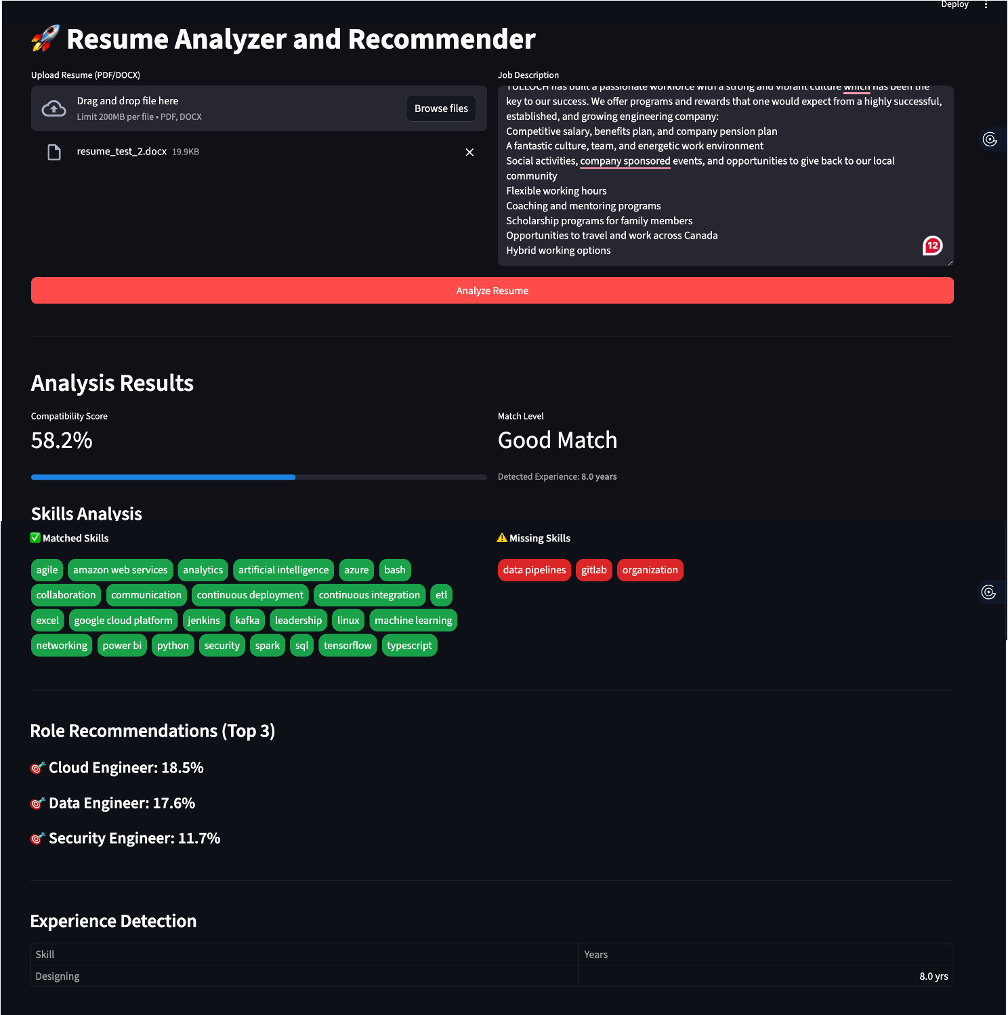
The Smart Resume Analyzer in Action
1. Simple Upload
1
2
2. Text box for Job Description
3. Analyze Button
3
4. At a glance score
4
5. Skill Gap analysis
5
6. Recommended Roles
6
7. Experience Detection
7

Slide 10
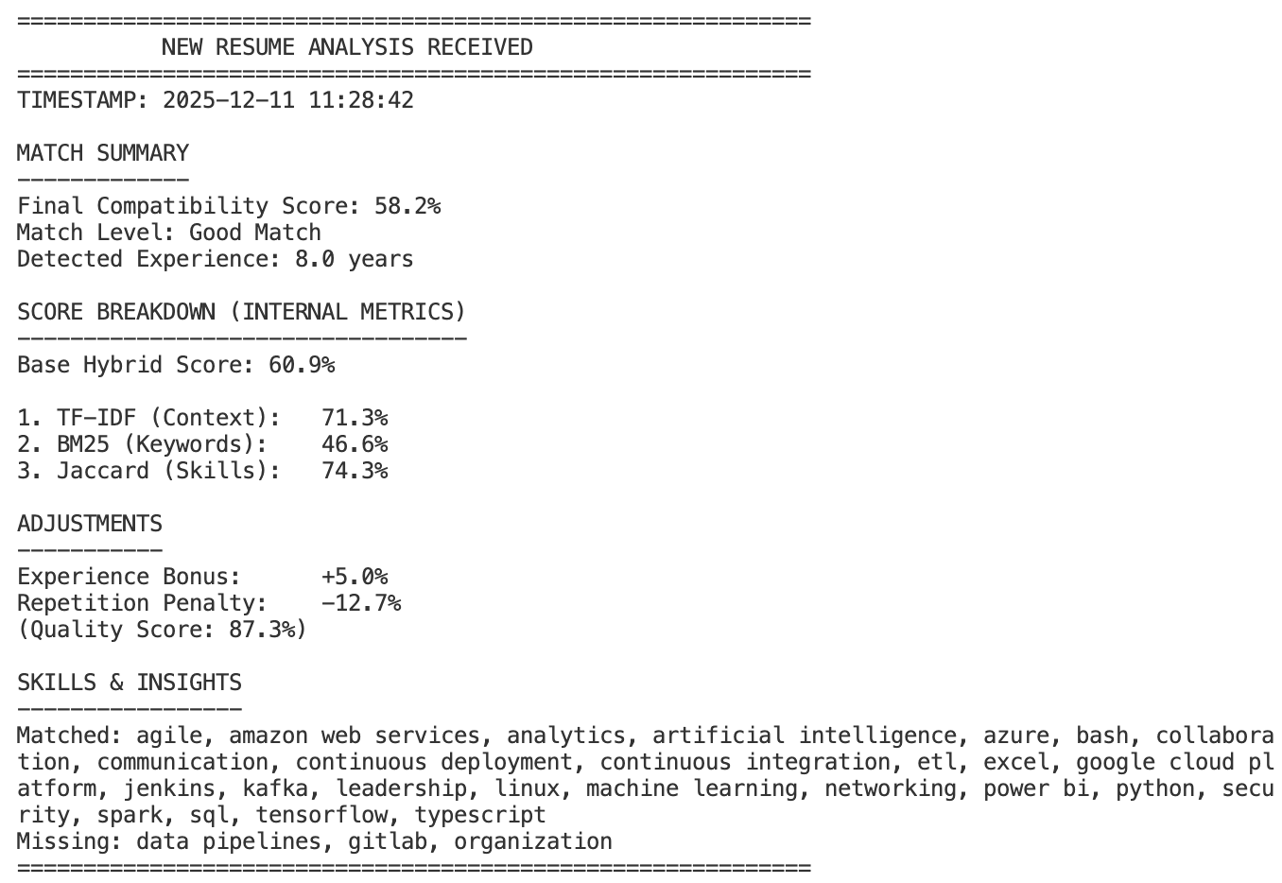
Behind the Scene Analysis Report
Timestamp
1
2
Summary Report
3
Hybrid Scoring
Refinements
4
Skills & Insights
5

Slide 11


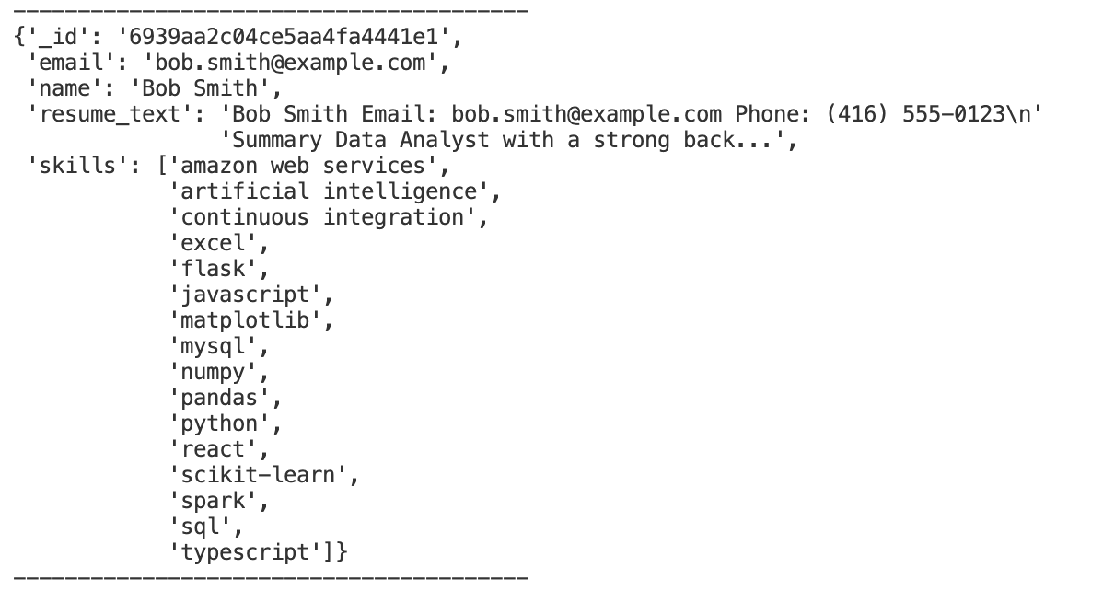
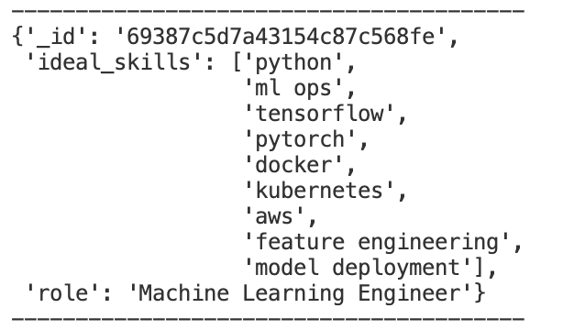
A Look Inside the Data: Our Database Schema
Candidates
Jobs
Purpose: Stores parsed information from every analyzed resume.
Purpose: Contains the seed job descriptions used for matching and recommendations.
A flexible NoSQL structure allows us to store rich, unstructured data efficiently and scale the system easily.

Slide 12





Key Capabilities and Achievements
Accurate & Nuanced Matching: Hybrid scoring system combines three algorithms for a holistic evaluation.
Intelligent Data Parsing: Real-time analysis of PDF and DOCX files with section-aware parsing (weighting Skills x3.0 and Experience x2.0).
Quality Assurance: Built-in keyword stuffing detection prevents score manipulation.
Proactive Opportunity Discovery: Generates a ranked list of recommended jobs for every candidate.
Secure & Self-Contained: 100% local deployment ensures data privacy and eliminates cloud dependencies.
• •
• •
Automated Experience Calculation: Intelligently extracts
total years of experience directly from resume text.
-(f)

Slide 13


The Roadmap: Future Enhancements
We successfully built a system that reduces manual screening effort by over 80% through consistent, bias-free analysis.
•••
@H
oOaO�
Smarter Al
Train a machine learning model on historical hiring data to further refine scoring accuracy.
Broader Reach
Implement multi-language support and integrate directly with major Applicant Tracking System (ATS) platforms.
Deeper Analytics
Develop an advanced reporting dashboard for recruiters to track trends and pipeline health.
Candidate Assistance
Add features like resume formatting suggestions based on job description analysis.

